Slide 1

Web Search Engine
Hetansh Shah
Yash Bhalala
Fahad Patel
Ramandeep Bhathal

Slide 2



Agenda
Purpose
Web Search Engine
Features
Conclusion and Future Scope

Slide 3




Purpose
To produce the high quality of search results
Fast results than normal search engine.

Slide 4


Web Search Engine
A search engine is a program that uses keywords or phrases to assist users to discover the information they're looking for on the internet.
When a user types in a search phrase, the search engine examines the website page titles, contents, and keywords it has indexed, then employs algorithms to generate a list of websites, with the most relevant sites at the top.
They usually deliver findings based on a backend crawling of many web pages and a data analysis algorithm.

Slide 5
Features
Web Crawler (Hetansh Shah)
Html to Text conversion (Hetansh Shah)
Text Suggestion (Ramandeep Bhathal)
Frequency of the word (Yash Bhalala)
Page Ranking (Fahad Patel)

Slide 6

Web Crawler
Web Crawler is a bot that crawls multiple webpages to provide the relevant webpages based on the search query of the user.
Crawling means checking the webpage and provide the results to the user if the results are relevant.
We have used Jsoup to connect various HTML links. Jsoup is a Java library that allows you to interact with real-world HTML.

Slide 7

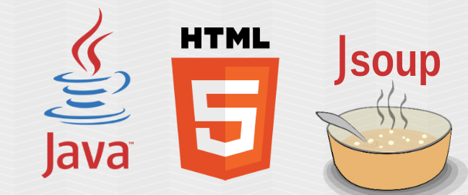
Html to Text conversion
Download the web pages in HTML format.
Conversion of Html file to Text file by removing the HTML tags using .parse() method which is provided by jsoup
Search engine will first work on HTML file and once downloaded the searches are done in a text file.
Using Jsoup help to ease the web crawling and conversion of the file from HTML to text file.

Slide 8
Text Suggestion
It will suggest some words similar or close to the input. User can choose any suggested word and then perform the search
The function will first fetch all the words and store it in a dictionary along with the frequency.
Dictionary stores the element in (key, value). Here key is the word and value is number of occurrence of the word.

Slide 9
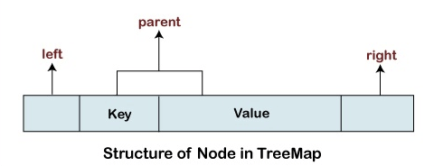
Text Suggestion
The function will then loop through each word in the dictionary and compare each word with the input and create a TreeMap<Integer,TreeMap<Integer,TreeSet<String>>>
TreeMap – class that implements Map, sorted, navigable map etc. Stores key-value pairs. It sorts the values by key.
TreeSet - Data structure is TreeMap. It implements SortedSet and navigable set to maintain and navigate the order of the elements. Sorts elements in ascending order using comparator.

Slide 10
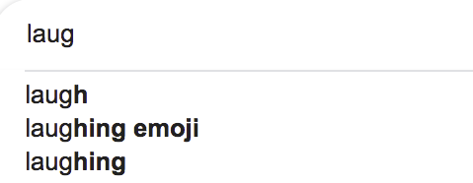
Text Suggestion
Edit Distance – calculate the similarity between input and word based on three operations – delete, insert and replace
Editdistance, word, frequency collected are added into the TreeMap.
The inbuilt functions in TreeMap will help in finding the top 3 words with lowest editdistance and highest frequency.
Then the 3 text suggestions will be displayed on the console and then user must select one

Slide 11
Frequency of the word
Frequency is used to help the page ranking feature to list the pages.
When a user enters any keyword search engine starts finding that word in every document present in the database and prepares one hash table of filename and occurrence of that word in that file.
To prepare final hashtable easily search engine is preparing creating hashtable for every document of every word and from that main hashtable it is searching for the specific word.

Slide 12
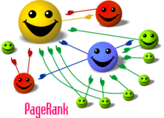
Page Ranking
Upon retrieving the web content, the crawler will add it to the index of visited pages and arranges the related content.
A search result is ranked according to its relevance.
To perform a search, search engines look through their index for data that is highly relevant to the search and then organize that data.
As a result, the higher a website's ranking, the more relevant it will be to a user's query.
Sorting algorithms are used for ranking and indexing functionalities.

Slide 13

Page Ranking
Look at its word frequency. If it has more "hits"(Word Frequency) we put it at the top of the list.
Sort the HashMap generated by the word frequency according to the number of keywords found in the document.
Finally, we sorted the HashMap to display the websites with highest number of rank using Collection.Sort() method.

Slide 14
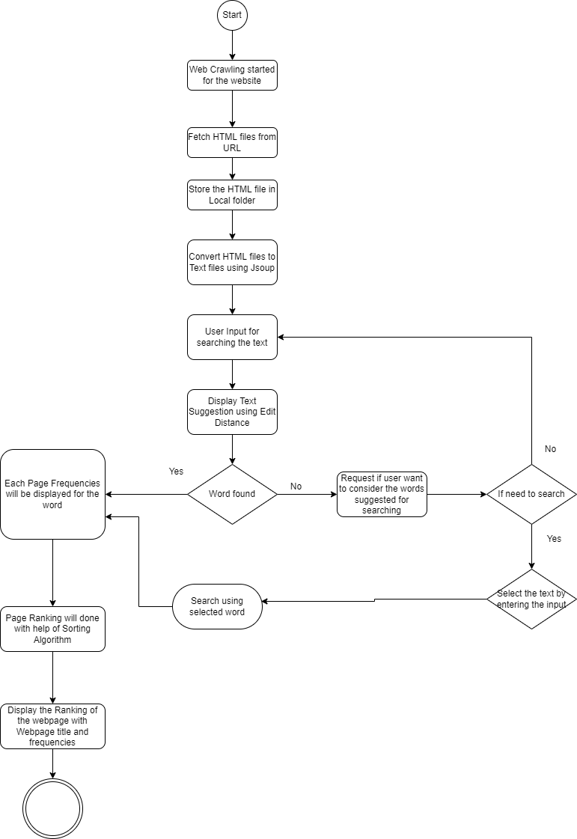
Implementation

Slide 15
Demo

Slide 16

Conclusion
Developing a Java search engine from scratch.
Revise and master the data concepts studied in the classroom.
Become familiar with the concepts used in a search engine.
Acquire more technical knowledge.
Collaboration skills are improved.

Slide 17
Future Scope
In the current version, the search engine is just a console application. Future plans include converting the search engine into a web application.
Currently we are crawling a few hundred pages but we are planning to crawl a thousand pages with the minimum time possible.
We are planning to run multiple tasks at the same time with multithreading to reduce the time complexity.

Slide 18
Roles and Responsibility
Team Member Name | Team Member Student Id | Feature
Hetansh Shah | 110074680 | Web Crawler and Html To Text Conversion
Yash Bhalala | 110085755 | Frequency of Word and Console Integration
Ramandeep Bhathal | 110074368 | Text Suggestion with TreeMap and editdistance
Fahad Patel | 110085698 | Page Ranking

Slide 19
References
https://www.javatpoint.com/how-treemap-works-internally-in-java
https://www.javatpoint.com/how-treeset-works-internally-in-java
https://www.geeksforgeeks.org/sorting-a-hashmap-according-to-values/
https://www.bdc.ca/en/articles-tools/entrepreneur-toolkit/templates-business-guides/glossary/search-engine
https://www.cloudflare.com/learning/bots/what-is-a-web-crawler/

Slide 20


Thank You

